Slide 1
News Report：
ISIS claims to be holding a Chinese man and a Norwegian man hostage
By Bolun Xu

Slide 3
ISIS online magazine Dabiq

Slide 5
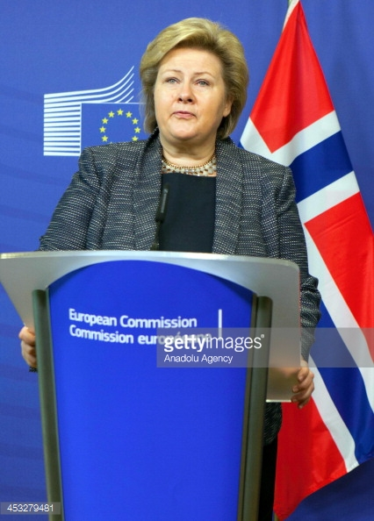

Slide 6
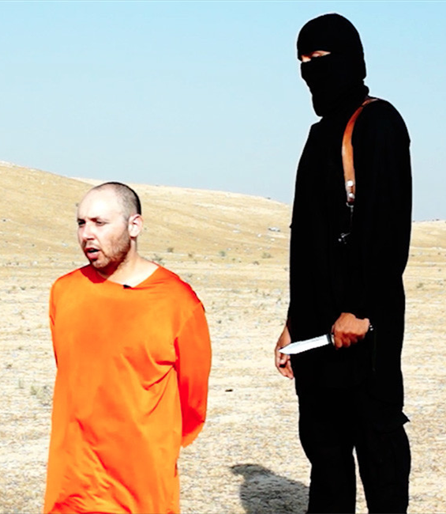

Slide 7


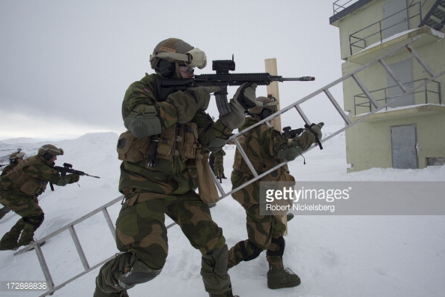
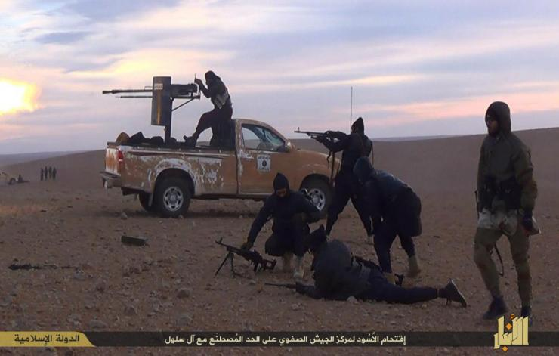

Slide 8
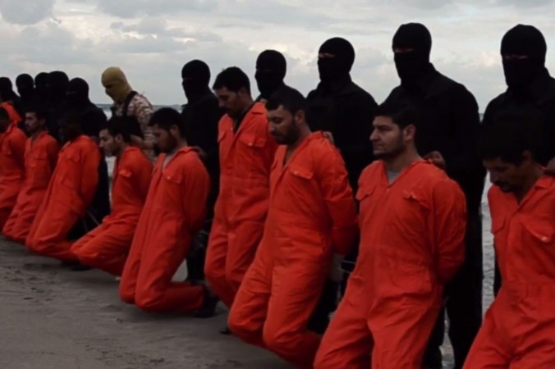

Slide 9

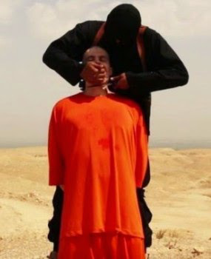
OR

Slide 10


Slide 11
Thank
you

